Slide 1


Lecture 1: Introduction to Artificial Intelligence
PUSL3123 AI and Machine Learning
Neamah Al-Naffakh
School of Engineering, Computing and Mathematics
Neamah.al-naffakh@plymouth.ac.uk

Slide 2
Today’s Topics
Introduction to Artificial Intelligence
Lesson learning outcomes: By the end of today’s lesson, you would be able to:
Describe the principal tasks in AI
Give examples of applications of AI
Summarise ethical considerations arising from the use of AI

Slide 3
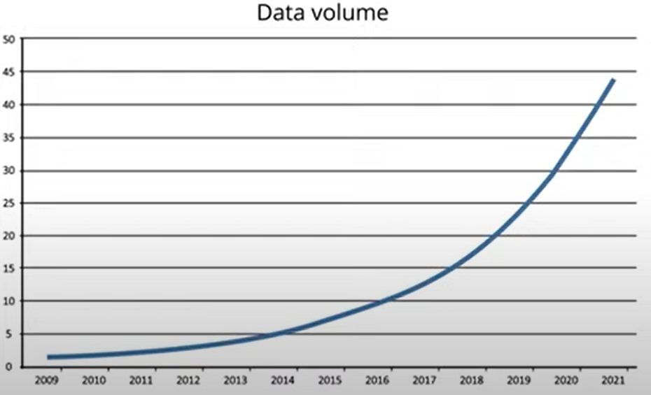

What is Artificial Intelligence
Data economy is a global digital ecosystem in which data is gathered,
organized, and exchanged by a network of vendors for the purpose of
deriving value from the accumulated information
Artificial Intelligence is the simulation of
human intelligence processes by machines,
especially computer systems.

Slide 4
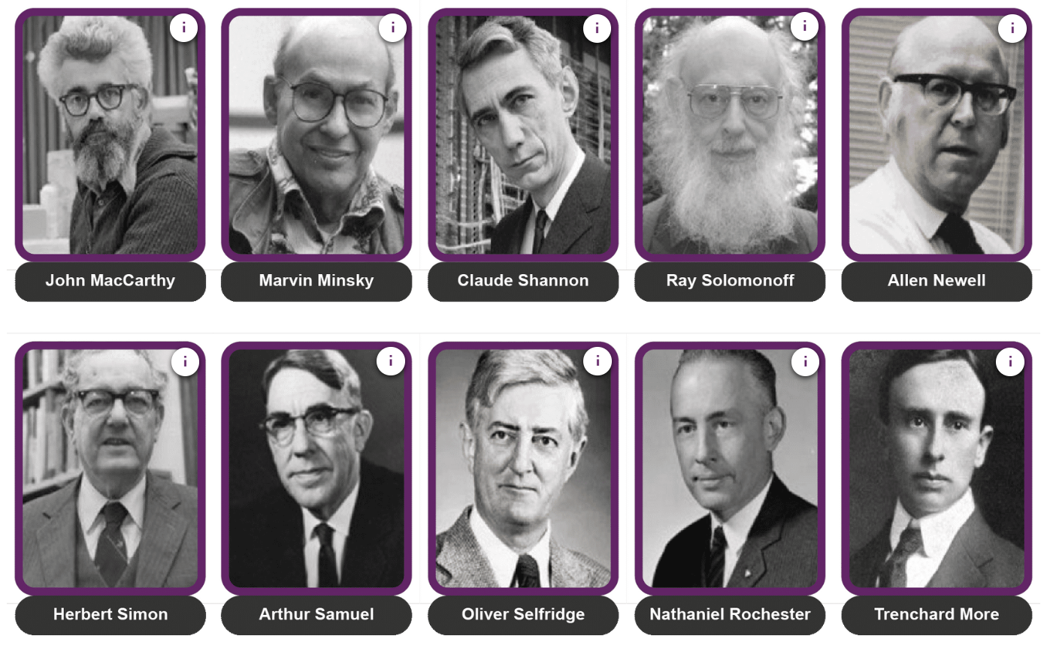
The Founding Fathers of AI

Slide 5
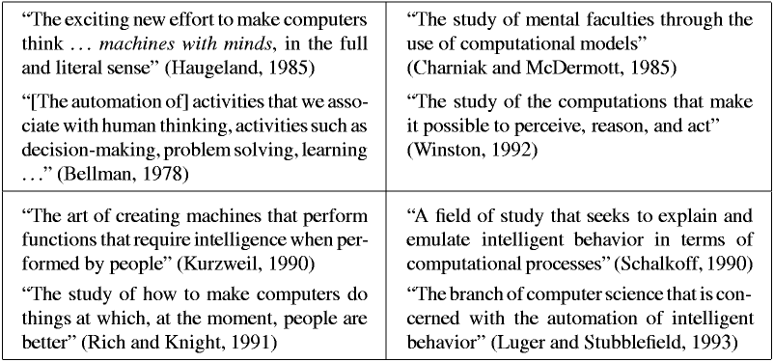
What is Artificial Intelligence

Slide 6
What is Artificial Intelligence
Definitions may be organised into four categories- Thinking Humanly, Thinking Rationally, Acting Humanly, Acting Rationally

Slide 7
What is Artificial Intelligence
Different definitions – depending on one’s background & worldview - Acting Humanly
“The art of creating machines that perform functions that require intelligence when performed by people.” (Ray Kurzwiel, ND)
“The study of how to make computers do things at which, at the moment, people are better.” (Rich and Knight, 1991)
Example : The Turing test (More details)

Slide 8
What is Artificial Intelligence
Different definitions – depending on one’s background & worldview - Thinking Humanly
“The exciting new effort to make computers think . . . machines with minds, in the full and literal sense.” (Haugeland, 1985)
“[The automation of] activities that we associate with human thinking, activities such as decision-making, problem solving, learning . . .” (Bellman, 1978)
Example : General Problem Solver

Slide 9
What is Artificial Intelligence
The difference between “acting humanly” and “thinking humanly” is that the first is only concerned with the actions, the outcome or product of the human’s thinking process; whereas the latter is concerned with modelling human thinking processes.

Slide 10
What is Artificial Intelligence
Different definitions – depending on one’s background & worldview - Thinking Rationally
“The study of the computations that make it possible to perceive, reason, and act.” (Winston, 1992)
“The study of mental faculties through the use of computational models.” (Charniak and McDermott, 1985)
Example: All computers use energy. Using energy always generates heat. Therefore, all computers generate heat.

Slide 11
What is Artificial Intelligence
Different definitions – depending on one’s background & worldview - Acting Rationally
“Computational Intelligence is the study of the design of intelligent agents.” (Poole et al., 1998)
“AI . . . is concerned with intelligent behaviour in artifacts.” (Nilsson, 1998)
Example, an agent that is playing a game will act rationally if it tries to win the game.

Slide 12
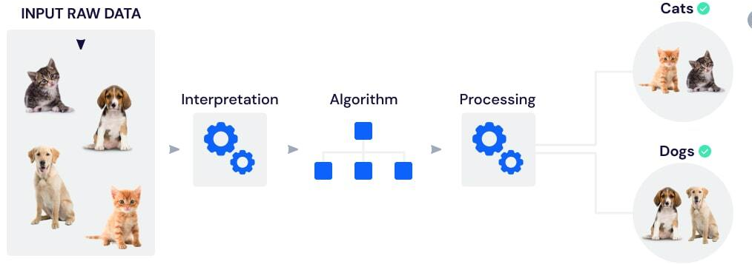
Core/Components of AI
Generalized Learning
Reasoning
Problem Solving
Generalized Learning
Demonstrate how well is a trained model to classify or forecast unseen data (i.e., react appropriately to
a new) situation

Slide 13
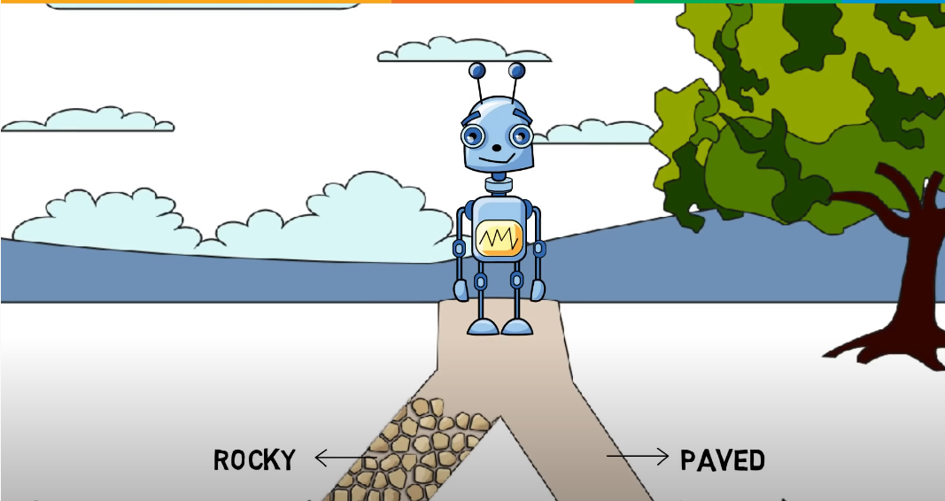
Core/Components of AI
Reasoning
The logical process of drawing conclusions, making predictions or constructing
approaches towards a particular thought with the help of existing knowledge

Slide 14
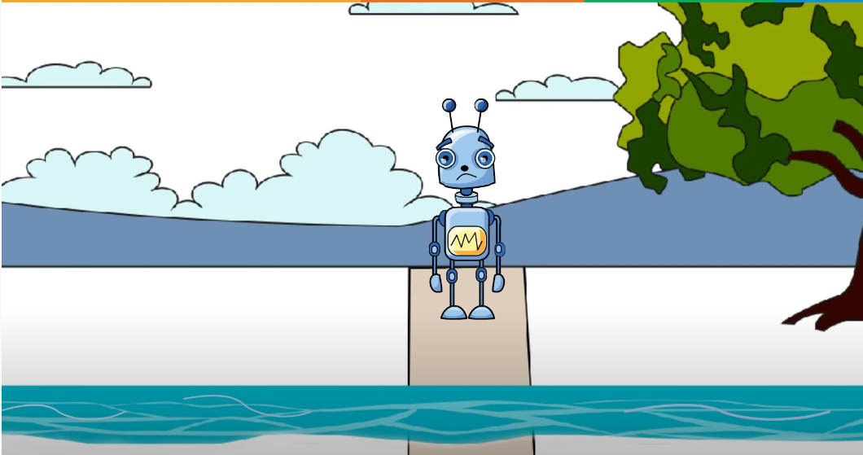
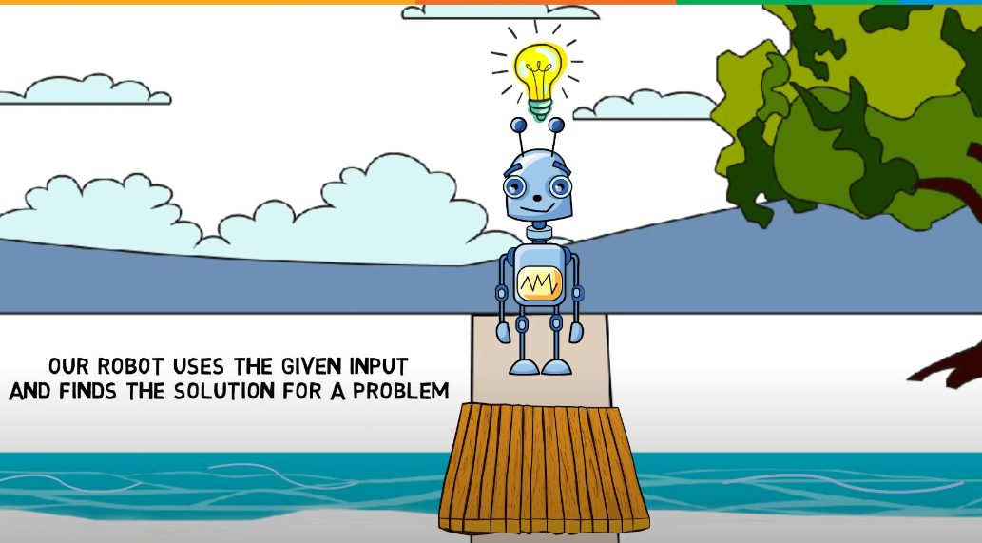
Core/Components of AI
Problem Solving
Reach the desired goal or find a solution to a given situation

Slide 15

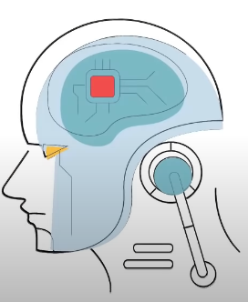


Core/Components of AI

Slide 16
Advantages of Artificial Intelligence
High Accuracy with less errors:
High-Speed:
High reliability:
Useful for risky areas:
Digital Assistant
Useful as a public utility

Slide 17
Disadvantages of Artificial Intelligence
High Cost
Can't think out of the box
No feelings and emotions
Increase dependency on machines
No Original Creativity

Slide 18
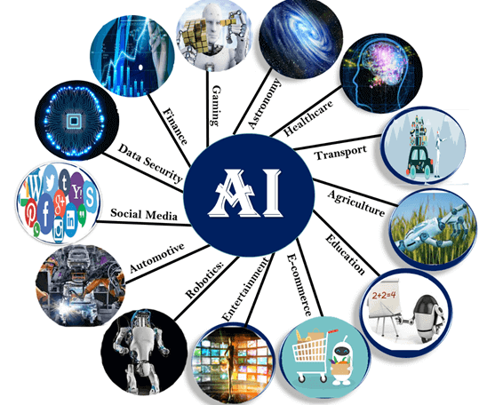
Applications of AI

Slide 19
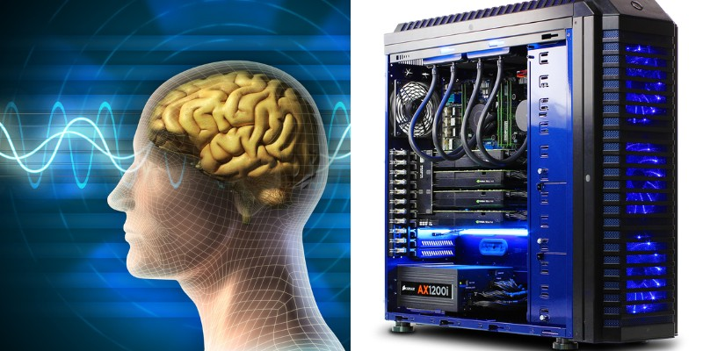
Human Brain vs Computers
The human brain
Receives inputs from our senses
Processes this information and makes decisions based on it
Learns from experience
Powerful memory
Computers
Use programs to process data in a pre-determined way
They can use data from a variety of inputs –cameras, microphones, the internet
They cannot think for themselves
How can we make computers “think”?

Slide 20
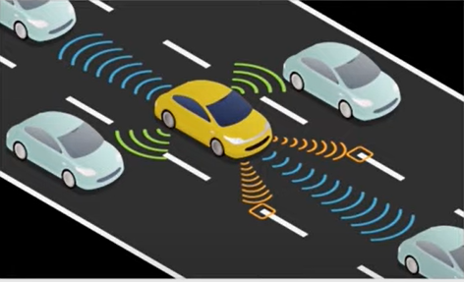
AI Examples- Self Driving Cars
Self driving cars are computer-controlled cars that drives themselves
Procedure
Cars that can get from A to B with no human control
Able to Navigate and Understand their environment (e.g., recognize and understand traffic signs, etc)
Could be safer
Benefits
Safer road (94% of accidents are caused by human error)
Better Accessibility
Reduced costs and maintenance requirements

Slide 21


AI Examples- Recommendation Systems
AI technology is used to create recommendation engines through which you can engage better with your customers
Amazon collect data from users and recommends the best products according to the user’s buying shopping patterns

Slide 22
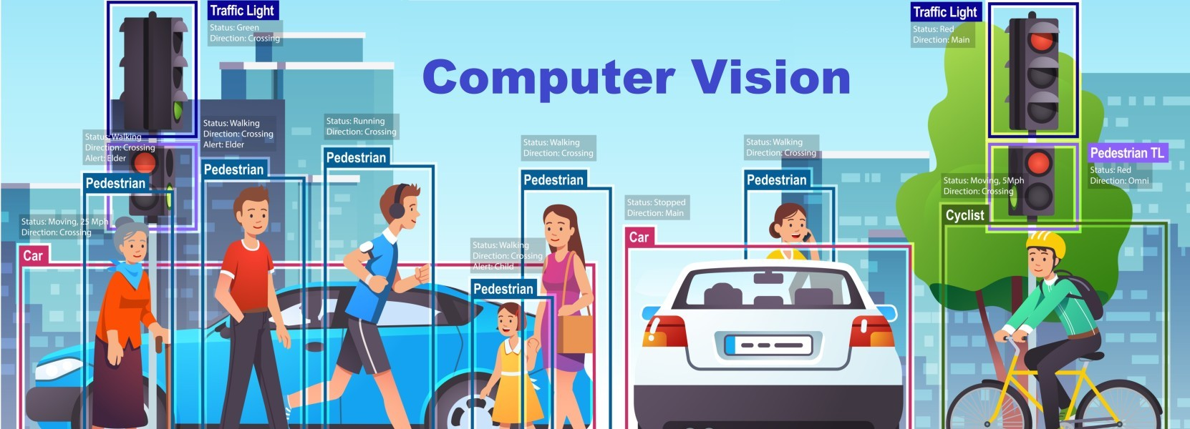
AI Examples- Computer Vision

Slide 23

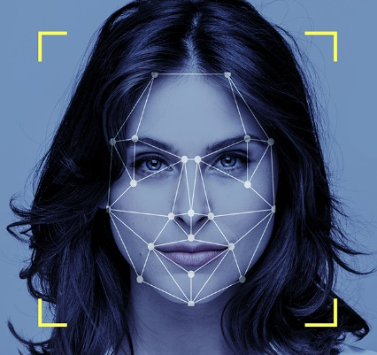

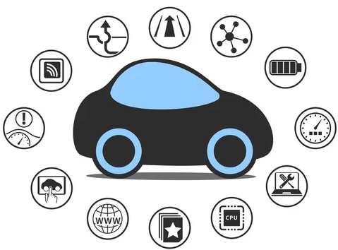

AI Examples- Computer Vision
The brain uses information from your eyes to process visual information
Identify and track objects
Our task is to build software that takes the information from cameras and performs the same task using machine learning
Applications of computer vision
Fraud detection
Image analysis
Autonomous cars
And More

Slide 24
Strong AI vs. Weak AI
Weak AI
Application specific / Task limited
Learn from thousands of labelled samples
Reflexive tasks with no understanding
Today’s AI
Example: voice activated assistance (Siri)
Strong AI
Perform general (human) intelligent action
Self learns and reasons with its operating environment
Learned from few samples and/or unstructured samples
Full range of human cognitive abilities
Future AI
Example: self driving cars

Slide 25
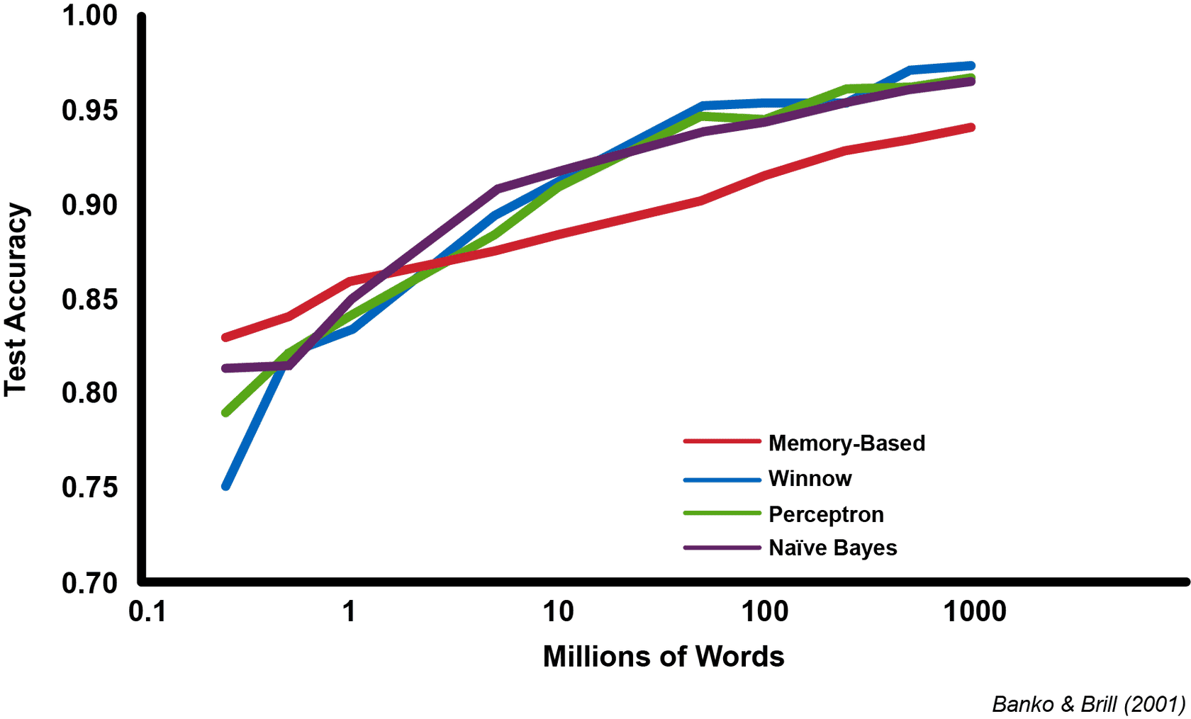
The Effect of Data Size on AI Algorithms

Slide 26
Challenges of AI
Data availability
Data quality
Cybersecurity & privacy
Algorithms

Slide 27

Algorithms
The first challenge is concerned with learning algorithms to be trained and how to determine whether the algorithms are performing as expected.?
This challenge will be discussed in greater detail during this module.

Slide 28
Data Availability
Data availability remains as a major challenge to overcome in order to go beyond the pilot stage.
ML and Deep Learning in particular require a very large amounts of (mostly labelled) data to achieve proper generalization.
Labelling raw data is a time consuming and costly endeavour which in this context frequently requires expertise and domain knowledge.

Slide 29

Data Quality
“Garbage in, garbage out”
Data quality is another challenge for AI. Even though a huge amount of data is being generated the quality of the data to be used to develop an AI system is critical.
Industrial AI and ML models rely heavily on accurate, clean and often appropriately labelled.

Slide 30
The Key Components of Quality Data in AI?
Accuracy : Accurate data produce correct and reliable outcomes
Consistency : Consistency ensures that data follows a standard format and structure, facilitating the efficient processing and analysis of the data
Completeness : Incomplete data sets can cause AI algorithms to miss essential patterns and correlations, leading to incomplete or biased results.
Timeliness : Outdated data may not reflect the current environment or trends, resulting in irrelevant or misleading outputs
Relevance: Relevant data helping AI systems to focus on the most important variables and relationships

Slide 31
What are the challenges of ensuring data quality in AI?
1-Data collection
Ensuring that all data points follow the same standards and eliminating duplicate or conflicting data is complex.
2-Data labelling
Manual labelling is both time-consuming and prone to errors.
3-Data storage and security
Maintaining data quality also means protecting it from unauthorized access and potential corruption.
4-Data governance
A lack of proper data governance can lead to siloed data, inconsistency, and errors.

Slide 32

Data Security and Privacy
AI’s need for large amounts of structured or standardized data with the human right to privacy
Cybersecurity is another challenge that needs to be addressed once an AI system has been deployed, particularly in cloud-based environments and on platforms that are connected to the internet such as internet-based services, as well as apps that have AI systems embedded

Slide 33
Ethics in AI
AI ethics is a set of values, principles, and techniques that employ widely accepted standards
of right and wrong to guide moral conduct in the development and use of AI technologies.
Ethical discussions occur around any new technology

Slide 34
Ethical Challenges of AI
Biases
How to eliminate bias from the dataset?
Control and the Morality of AI
Does AI in control of the situation?
Privacy
What are the rules around the data collection?
What legislation might need to be put in place to protect users’ private information?
Ownership
Who is responsible for some of the things that AIs are creating?
Humanity
How does AI make us feel as humans?

Slide 35

Conclusion
AI is an extremely powerful and exciting field. It’s only going to become more important and ubiquitous moving forward, and will certainly continue to have very
significant impacts on modern society.
AI helps in the execution of daily tasks. the end goal of
using AI for any process is to increase the efficiency and
productivity of the target area.
AI is classified into Strong AI and Weak AI. Both
types of AI are different from each other. Their
origin and application at different.

Slide 36
Reading List
Artificial Intelligence –A Guide for Thinking Humans- Melanie Mitchell, Pelican Books, 2019
Machines that Think - New Scientist, 2017
Journal Papers and other articles- Additional suggested/recommended reading that will help you improve your understanding of the material
Next Lecture
Introduction to Machine Learning

